Slide 1


Data Analysis Using
Python
Lecture-6
www.bennett.edu.in
www.bennett.edu.in

Slide 2
Data Normalization
Data Normalization is a common practice in machine learning which consists of
transforming numeric columns to a common scale
. After normalization, all variables have a similar influence on the model, improving the stability and performance of the learning algorithm.
www.bennett.edu.in

Slide 3
Multiple methods
Min Max Scaling Z score Scaling
Log Transformations
www.bennett.edu.in

Slide 4

Min Max Scaling
The min-max approach (often called normalization) rescales the feature to a fixed range of [0,1] by subtracting the minimum value of the feature and then dividing by the range
www.bennett.edu.in

Slide 5
Try Yourself to scale
Person | Height
M1 | 164
M2 | 167
M3 | 169
M4 | 163
M5 | 175
www.bennett.edu.in

Slide 6
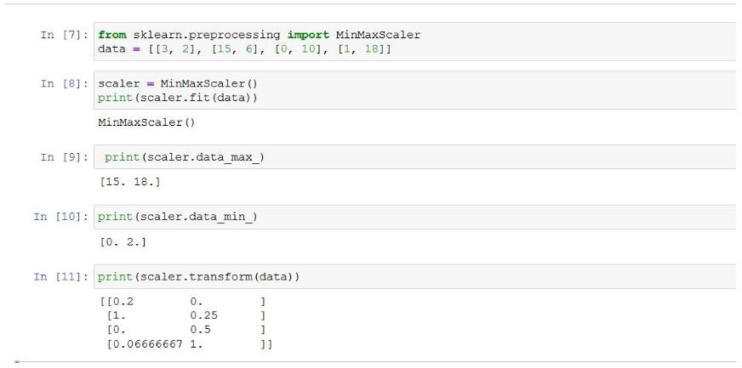
Python
www.bennett.edu.in

Slide 7
Normal distribution
The probability of occurrence of a continuous variable is usually depicted by a normal distribution. It can be shown both mathematically and by experiments on probability that as the number of the measurements increases and there are no specific variables at work, the measures are distributed in such a way that if a frequency polygon is drawn for the measurements, it approaches the shape known as the normal curve.
Thus a normal probability curve depicts exactly the same thing as a frequency polygon. The frequency polygon shows the frequency of measurements against scores on the x – axis.
However, the normal distribution serves as a mathematical model applied to diverse kinds of data. Thus in the NPC, the scores are depicted in terms of mean and standard deviation i.e. they are standard or z scores.
www.bennett.edu.in

Slide 8
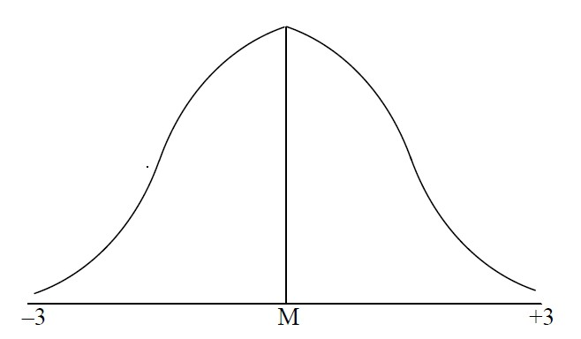
Normal distribution
www.bennett.edu.in

Slide 9
Properties of NPC
All the three measures of central tendency i.e. Mean, Median and Mode fall
at the same point in the NPC.
The curve is symmetrical around its highest point. If the curve is divided into two parts by a perpendicular dropped from the highest point, the figure shows perfect bilateral symmetry.
The ordinate (height) at the Mean is the highest and the highest points of other ordinates at various distances from the mean are also in a fixed relation to the height of the mean ordinate. This implies that the proportion of cases falling at various points on the baseline is also fixed. It also implies that the area covered by the curve is fixed.
The curve is based on the baseline, which extends from -3 to +3. The
midpoint is the mean.
www.bennett.edu.in

Slide 10
Properties of NPC (Contd.)
The curve is asymptotic i.e. it continues to approach but never meets the base line. It implies that certain percentage of cases which are not covered by the curve or which fall beyond 3 S.D. However, for the purpose of calculations it is generally assumed that either side of the curve covers p = 0.5000
The first and the third quartiles i.e. 25th percentile and 75th percentile are equidistant from the mean.
The NPC is unimodal i.e. there is just one peak. It has only one highest point.
The normal distribution is a mathematical model based on a mathematical equation. When represented graphically, it shows a bell like shape – not just any bell like shape but a precise shape that follows an exact mathematical equation.
www.bennett.edu.in

Slide 11

Equation of the curve
where y
N
σ
π e x
Frequency or height of the curve Number of observations or cases Standard deviation of the distribution 3.1416 or 22/7
2.7183 (approx.) i.e. base of Napierian system of logs. the deviation of each score from the mean
www.bennett.edu.in

Slide 12
Applications of NPC
If a set of scores is given (and their Mean and SD are already calculated), one can use
the NPC:
To find the proportion of cases falling between any two given scores in the distribution. If raw scores are given, they are first converted into z-scores by the formula:
_{± z =} X − M
SD
Where z is the z score
X is the raw score M is the mean
SD is the standard deviation
Then the proportion is looked up in a table depicting areas in the normal distribution. This proportion can then be converted into a percentage by multiplying by 100, or a frequency by multiplying by N.
www.bennett.edu.in

Slide 13
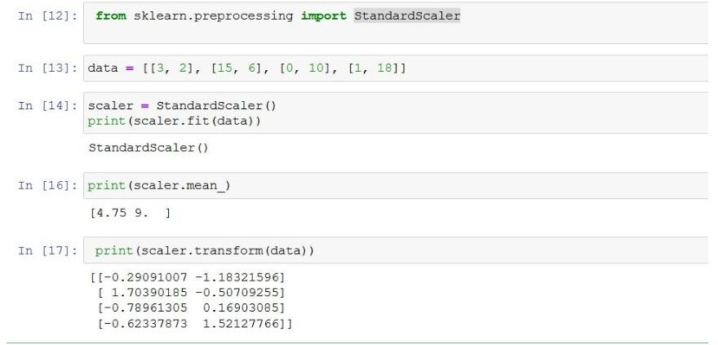
Python
www.bennett.edu.in

Slide 14

Log Scaling(transformation)
Log scaling computes the log of the values to compress a wide range to a narrow range. In other words, it helps convert a skewed distribution to a normal distribution/less-skewed distribution. To perform the scaling, take the log values in a column and use them as the column instead.
www.bennett.edu.in

Slide 15
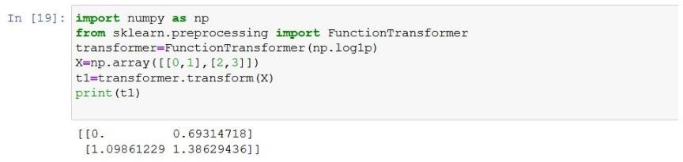
Python
www.bennett.edu.in

Slide 16
Pearson Correlation
Correlation between sets of data is a measure of how
well they are related
The most common measure of correlation in stats is the Pearson Correlation
It shows the linear relationship between two sets of data.
The formulas return a value between -1 and 1, where:
1 indicates a strong positive relationship
-1 indicates a strong negative relationship
A result of zero indicates no relationship at all
www.bennett.edu.in

Slide 17
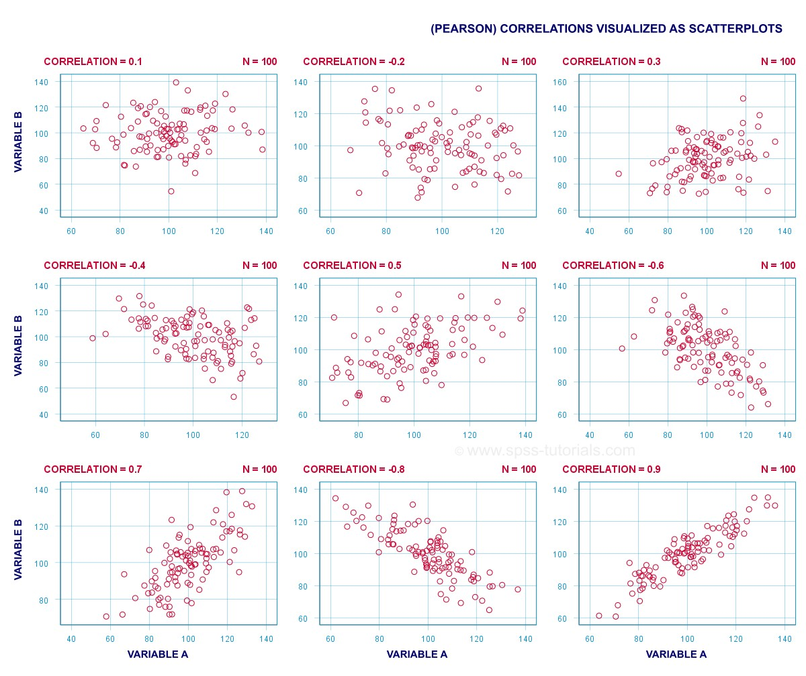
www.bennett.edu.in

Slide 18

How to Calculate
S No. | Study hours Variable A (x) | Score Variable (y)
1 | 5 | 10
2 | 3 | 7
3 | 4 | 8
4 | 1 | 4
5 | 2 | 5
6 | 3 | 6
www.bennett.edu.in

Slide 19



S. No | . | x | y | xy | _{x}2 | _{y}2
1 |  | 5 | 10 | 50 | 25 | 100
2 |  | 3 | 7 | 21 | 9 | 49
3 |  | 4 | 8 | 32 | 16 | 64
4 |  | 1 | 4 | 4 | 1 | 16
5 |  | 2 | 5 | 10 | 4 | 25
6 |  | 3 | 6 | 18 | 9 | 36
Σ |  | 18 | 40 | 135 | 64 | 290
www.bennett.edu.in

Slide 20

www.bennett.edu.in

